Slide 1
Data Science Capstone Project
Data Driven Decision for the best place to open a restaurant in New York

Slide 2
TOC
Introduction
Problem Description and background
Target Audience
Data
Sources
Usage
Methodology
EDA
Inferential statistical testing
ML Algorithms
Notebook
Results
Discussions
Conclusions
Notes:
or this week, you will required to submit the following:
A description of the problem and a discussion of the background. (15 marks)
A description of the data and how it will be used to solve the problem. (15 marks)
For the second week, the final deliverables of the project will be:
A link to your Notebook on your Github repository, showing your code. (15 marks)
A full report consisting of all of the following components (15 marks):
Introduction where you discuss the business problem and who would be interested in this project.
Data where you describe the data that will be used to solve the problem and the source of the data.
Methodology section which represents the main component of the report where you discuss and describe any exploratory data analysis that you did, any inferential statistical testing that you performed, if any, and what machine learnings were used and why.
Results section where you discuss the results.
Discussion section where you discuss any observations you noted and any recommendations you can make based on the results.
Conclusion section where you conclude the report.
3. Your choice of a presentation or blogpost. (10 marks)

Slide 3
Introduction

Slide 4
Introduction
Prepared for IBM Data Science Capstone Project - The Battle of Neighborhoods
Use techniques learned in the course for
Exploring and comparing geographical location
Leveraging the Foursquare APIs
To lead to a data driven suggestion for opening a new restaurant in New York

Slide 5
Target Audience

Slide 6
Target Audience
Target Audience for this presentation are the potential Restaurateurs who would like to open a new restaurant
It can also be used by potential investors for gauging the popularity of a particular restaurant
Sample Template for Data Scientists for Exploratory Data Analysis techniques

Slide 7
Problem Description

Slide 8
Introduction
Opening a new restaurant in New York
Concept
Target Market - Identify gaps in cuisine, service.
Competitors – Who are the competitors?
Location
Where ? – Depends upon the Target Market, Business Model and competitors
Parking? – Without adequate parking, people may not come
Visibility? – Is the location at a prominent place?

Slide 9
Data Sources

Slide 10
New York
Divided Into 5 boroughs
Further each borough is divided into Community Districts
Each community districts has zoning areas

Slide 11
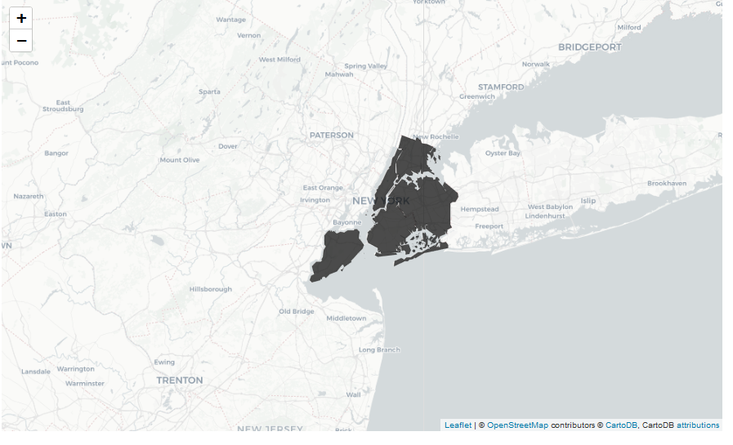
Boroughs

Slide 12
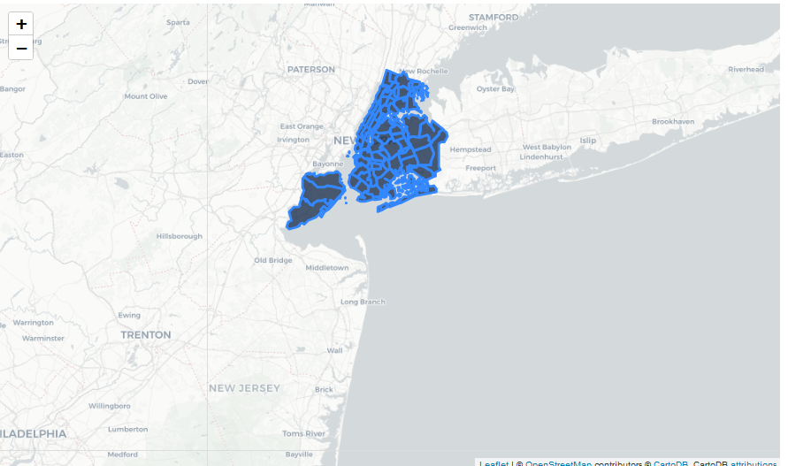
Community Districts

Slide 13
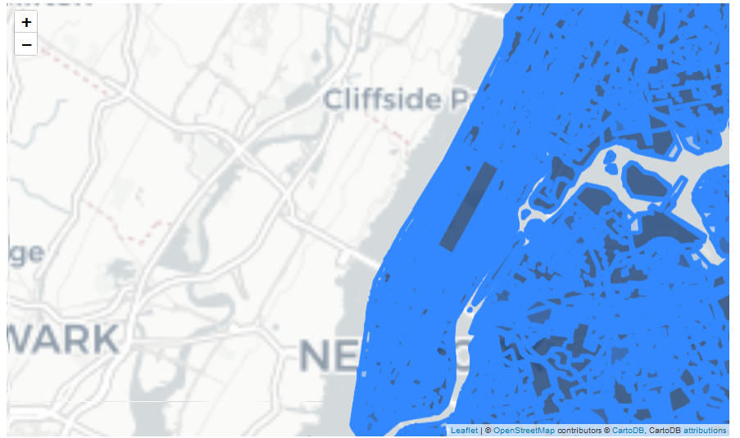
Zoning Areas

Slide 14
Why Finding the Population Base Is Important - Target Market
You might assume that you know enough about a particular location if you're opening in your own hometown or a local neighbourhood. You might think that doing any further research is unnecessary. This can be a costly mistake.
Really digging into the numbers in your area, from housing values, average household income to average age, then contrasting this information with the number of competing restaurants in the area, will help you determine the best type of restaurant to open.
You might tailor your concept to millennial customers rather than a baby boomer population if the average age in the area is 27.
Data Source
https://en.wikipedia.org/wiki/Economy_of_New_York_City

Slide 15
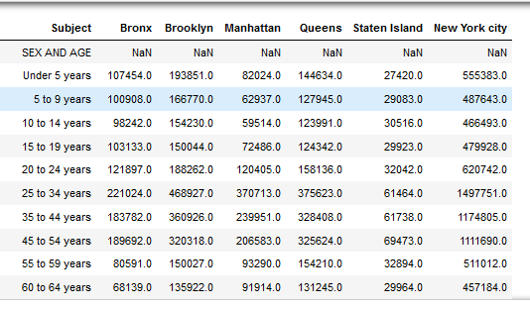
Population Base

Slide 16
Competition - Know Your Neighbours
When looking for a restaurant location, consider who else is doing business in the neighbourhood. Are there already half a dozen restaurants with the same concept as yours? Is the area busy or full of empty storefronts? Successful businesses attract other successful businesses.
Data Source
https://data.cityofnewyork.us/Health/DOHMH-New-York-City-Restaurant-Inspection-Results/rs6k-p7g6
https://geo.nyu.edu/catalog/nyu_2451_34572

Slide 17
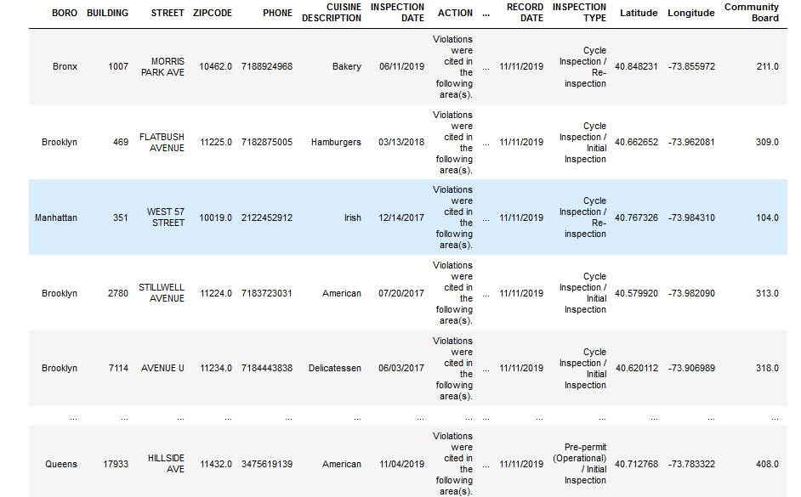
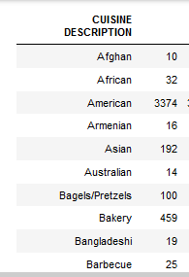

Slide 18
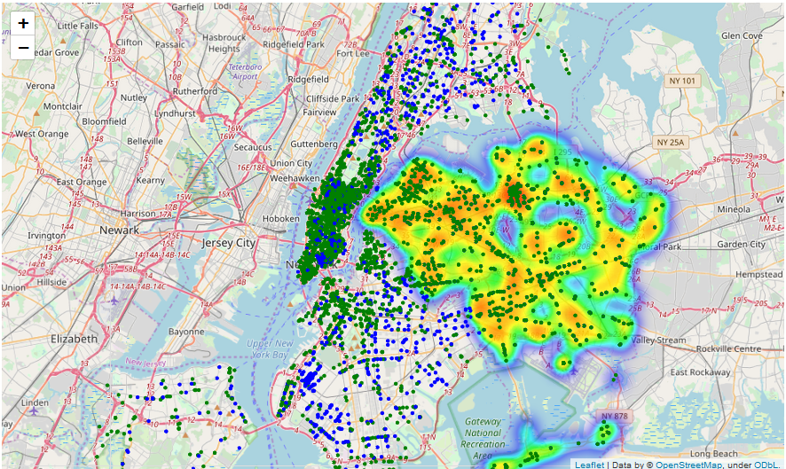

Slide 19
Location - Zoning Ordinances – Where?
Some locations are obviously in commercial zones, such as busy downtowns and developed strips of highway. Other locations may be on the fringes of a commercial and or residential zone. Find out if the building is properly zoned for a restaurant. Some towns prohibit the sale of alcohol within so many feet of a church or house of worship, while other towns still maintain “dry” ordinances left over from prohibition.
Data Source
https://data.cityofnewyork.us/City-Government/Zoning-GIS-Data-Shapefile/kdig-pewd
Notes:
https://www.sla.ny.gov/

Slide 20
Zoning Areas

Slide 21
Location - Parking
People are lazy. There is just no way around it. If they have to walk a fair distance to get to your restaurant, they may opt to go somewhere else "more convenient." If you live in an urban area where everyone walks and there is public transportation, this is less of a factor. If you are thinking of a restaurant location out of town, in a place that requires you to drive to get there, you'd better have parking available. If your restaurant location doesn't come with a large parking lot, is it near a municipal parking lot for patrons to use?
Data Sources
https://data.cityofnewyork.us/City-Government/Parking-Lots/e2f7-cs7i
https://data.cityofnewyork.us/Business/parking-garage-list/5bhr-pjxt
Notes:
Four Important Factors
Parking: Ideally, a new restaurant location should have its own parking lot. If that isn’t an option—for example, in a major city—consider partnering with a hotel in the area that has its own parking options. Many famous restaurants are housed in hotels, and for a good reason. Not only is there parking, but the benefit of foot traffic that is staying right upstairs is incalculable.
Accessibility: There’s a reason that major restaurant chains are often located near highway exits: It makes them accessible for customers. Certain restaurants can get away with food or service that isn't the best simply because their locations are so accessible, like restaurants near the Eiffel Tower or Collisseum. There is plenty of foot traffic in urbanized areas, and restaurants only need to attract customers from the street into their business. Most successful restaurants—other than the truly elite—are easy to find, and you will find them in city centers or unique locations throughout the world.
Visibility: This goes along with accessibility and is very important for new restaurant locations. People have to know the restaurant is there, either in person or on their mobile devices. It is why property prices in downtown districts and developed strips are higher than in other areas. They offer a level of visibility that can bring in a great deal of walk-in business. Consider advertising in search engines and social media to enhance your presence across all forms of media. Make sure to register your restaurant in search engines as the type of food you offer and your price point, as it will be easier to attract the clientele you want when they go to search.
Population Base: Are there enough people in the area to support your business? There need to be enough people who live in or pass through the area regularly to keep you busy. To determine a particular area's population base, you could do a site study. However, these can cost up to $25,000. Most people looking at their first restaurant don’t have enough money in their budget for a professional survey. A less expensive method to determine the population base of a certain area is to use a pie chart, as well as asking the local chamber of commerce and town office for more information. If you would rather pound the pavement, simply walk around the area where you plan to build. Intuition can place a big role in choosing your site.

Slide 22
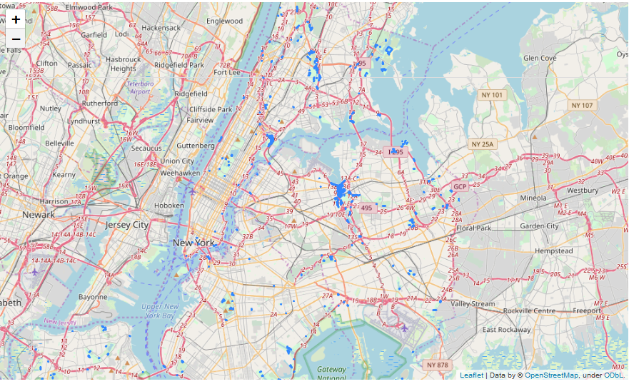

Slide 23
Location - Visibility
Setting up shop in a location with either high foot or car traffic is ideal. Making your restaurant (or restaurant sign) visible to the public is like free advertising. It reminds them that your restaurant exists and they should stop by for dinner sometime.
Data Sources
https://en.wikipedia.org/wiki/Economy_of_New_York_City
https://en.wikipedia.org/wiki/Cuisine_of_New_York_City

Slide 25
Open Data – NYC
Open Data is a veritable source of openly available data for New Yorkers that is produced and used by City government. The relevant data sets have been referenced in the above slides, with the specific problems which they will be used to tackle.
Wikipedia is another major source of data, which can be used to cross reference the various aspects of New York.

Slide 26
References
These links actually were very helpful in collating and collecting information for understanding the business domain
https://www.thebalancesmb.com/how-to-find-out-the-population-base-of-an-area-2888660
https://www.fundera.com/blog/starting-a-restaurant
https://www.thebalancesmb.com/before-you-choose-a-restaurant-location-2888548
https://www.thebalancesmb.com/choosing-restaurant-location-2888543

Slide 27
Methodology

Slide 28
Locations
Find out the location of the restaurant now..
find out how many Chinese restaurants are there in the Queens and plot
find a neighborhoods where there are not many chinese restaurants, but has a high concentration of other restaurants
Plot the data of Chinese Restaurants in Queens

Slide 29
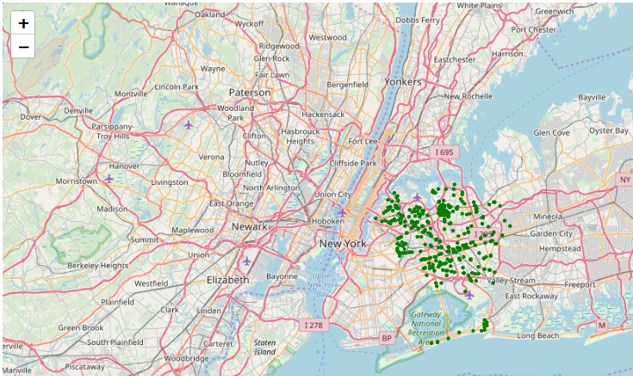

Slide 30
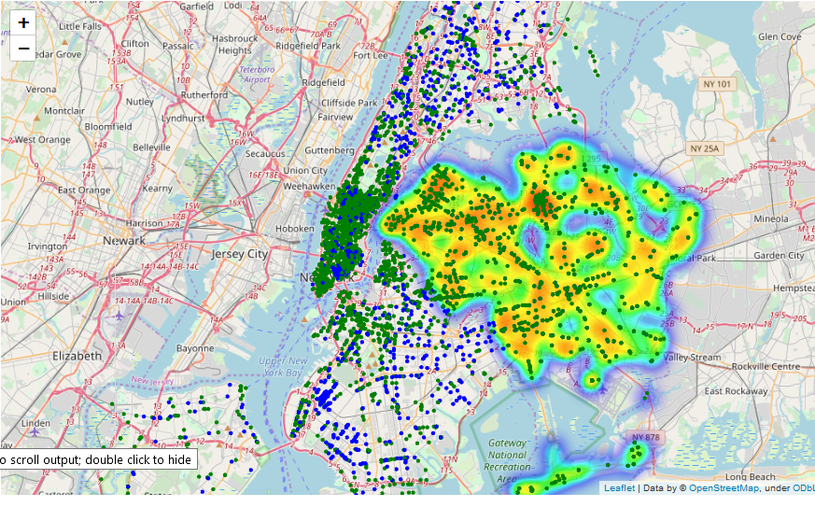
Explore the hotspots and overlay it with Chinese Restaurants

Slide 31
Notebook Link

Slide 32
Running all the cells in the notebook and trying to upload it to GitHub was giving a file too big error, as the size was becoming more than 25mb. Hence I have run only relevant cells in the notebook. All the maps/data outputs are there in the report and the presentation. Please consider that before final grading. Thanks https://github.com/smukherjee/Coursera_Capstone/blob/master/CapstoneRestaurantOpening.ipynb

Slide 33
Results and Discussions

Slide 34
From our Analysis,
We have been able to identify the Restaurant hotspots in Queens
We have been able to identify and shortlist the areas where there are enough Restaurants, but there are not too many Chinese Restaurants
As a result of our analysis there are 8 areas which a potential restaurant owner can further explore on opening up of a Chinese Restaurants. The people in these areas have an habit of eating out, and the market is not saturated with Chinese restaurants.
Further Analysis could be done on
Parking availability
Zoning Licenses and Liquor licenses
Existing properties available

Slide 35
Conclusions

Slide 36
This project could be used as a starting point for a potential restaurant owner to shortlist areas for opening a restaurant.
Extensive analysis and availability of the data, it will also become easier in case, the owner is not interested in opening a Chinese Restaurant but interested in looking at an alternate cuisine.
Since all the dataset used are publicly available and updated constantly, I hope that the work done remains relevant for some time to come.

Slide 37
References

Slide 38
Report: https://cocl.us/coursera_capstone_report
Notebook: https://cocl.us/coursera_capstone_notebook
Presentation: https://cocl.us/coursera_capstone_presentation

Slide 39
Concept
Target market—the group of people whom your restaurant is meant to serve. Getting an answer and narrowing down this will
Enable is to create a menu,
Create an overall experience
Build marketing campaigns for them
For profiles
Demographic profiles
Competitors
Parking availability
Costs

Slide 40
Concept
Restaurants come in all shapes and sizes, from food trucks to major franchises. The first step for you is narrowing your interests down to one type of eatery.

